Slide 1
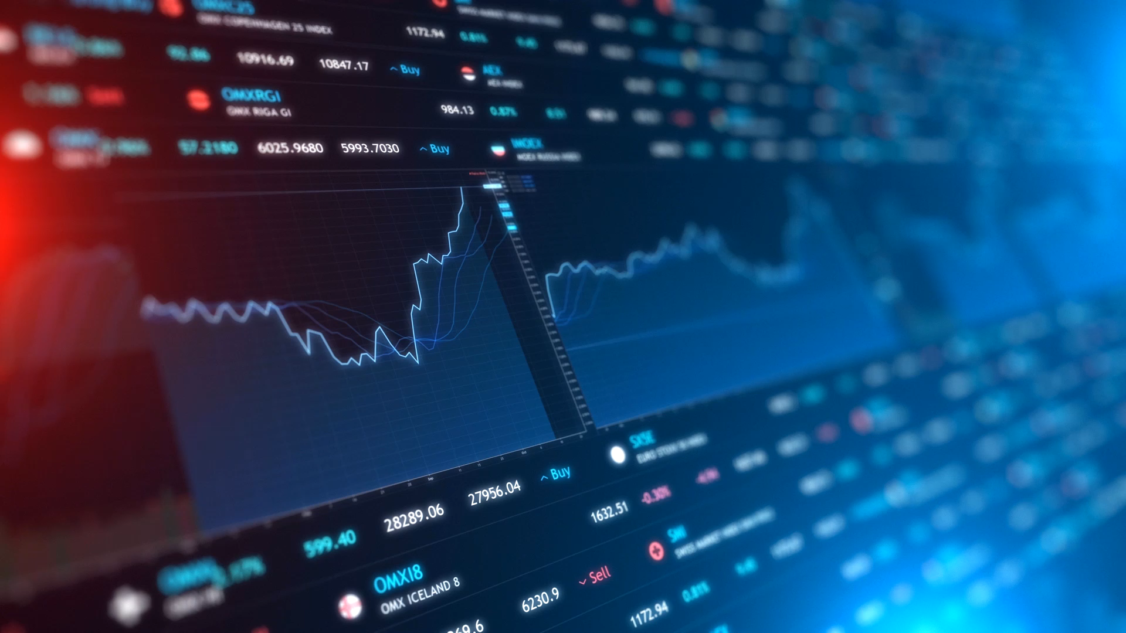
Stock trading with Reinforcement Learning
Final Project Presentation
Jonas | Lorena | Mohamad | Viktoria

Slide 2

Abstract From literature to our concept
Literature research
On Reinforcement Learning (RL)
On sensitivity analysis
Motivation
Trading bot maximizing risk adjusted returns
Explainability behind decisions/trades (xAI)
Novel ideas
Integration of sentiment data per stock among technical indicators
Sensitivity analysis to make explainable and transparent
Enhanced feature engineering and data pre-processing

Slide 3


Approach Step by step automated pipeline
Data selection
Model training
Sensitivity analysis
1101001
0001010
0110100
1011001
Data pre-processing
Backtesting

Slide 4
Approach Step by step automated pipeline
1101001
0001010
0110100
1011001

Slide 5
Data selection Representation of US stock market
30 most important stocks
Apple, Amazon, Microsoft, Tesla, Alphabet…
Two years range: Nov 2021 – Sep 2023
Intraday: Hourly
Interday: Daily
Financial markets data
Alpha Vantage API
OHLCV: Prices and Volume
VIX index
Sentiment data
Financial Modeling Prep API
likes, impressions, sentiment
1101001
0001010
0110100
1011001

Slide 6
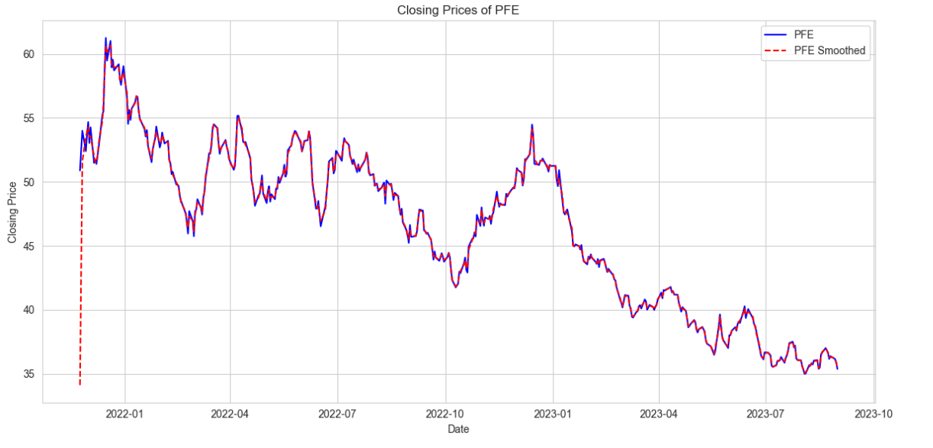
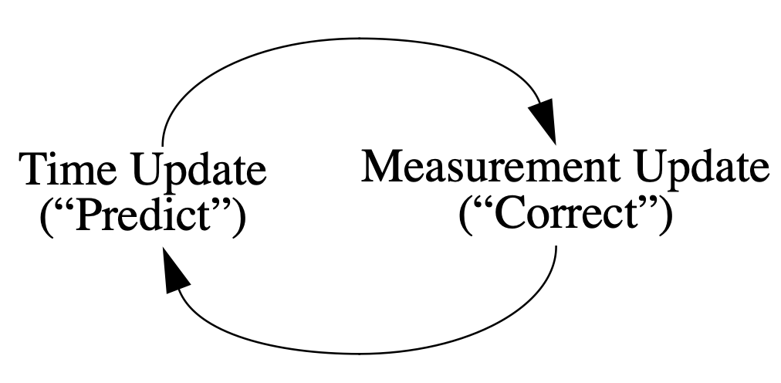
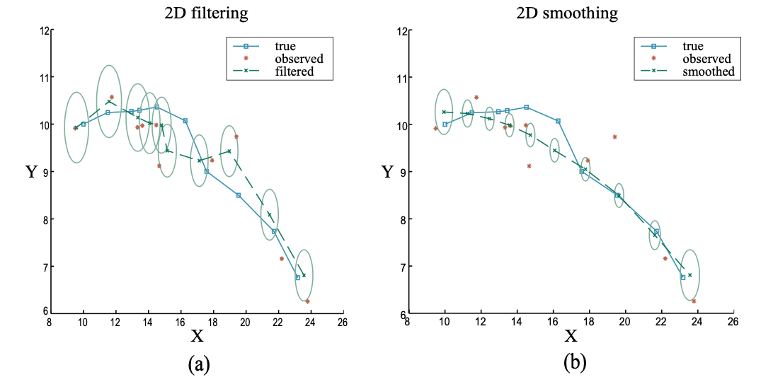
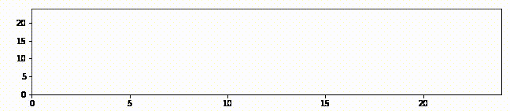
Data pre-processing Step by step automated pipeline
Stock Splits
Technical indicators
MACD, Bollinger Bands, RSI, CCI, …
VIX and turbulence index
Test-Train Split (80/20)
Kalman Filter
Correction
Observation
Data Normalisation
Log Returns
Min-Max normalisation
Training dataset
Evaluation
Source: https://github.com/rlabbe/Kalman-and-Bayesian-Filters-in-Python
Accessed 17.09.2023
Source: Stuart Jonathan Russell and Peter Norvig. Artificial Intelligence – A Modern Approach. Pearson, 4th edition, 2021, p. 502
1101001
0001010
0110100
1011001
Notes:
@Jonas

Slide 7
Model training Global framework: State, Environment and Agents
Reward: Profit/Loss
Trading Agents
Environment
A2C
Budget
Action: sell/hold/buy
Stock Prices
DDPG
{-k, …, -1, 0, 1, …, k}
Portfolio
PPO
Tech. Indicators
TD3
Volume
Log Returns
SAC
Sentiment
State: observations
1101001
0001010
0110100
1011001

Slide 8
Model selection Global parameters
Agents
Advantage Actor Critic (A2C)
Proximal Policy Optimization (PPO)
Soft Actor-Critic (SAC)
DDPG
TD3
Approach
Train and improve the hyperparameters:
Model parameters
Normalized/ non-normalized
Transaction costs
Turbulence threshold
Smoothed/ non-smoothed
Daily/Hourly
Sentiment data vs. w/o
Evaluate and compare with benchmarks
1101001
0001010
0110100
1011001

Slide 9
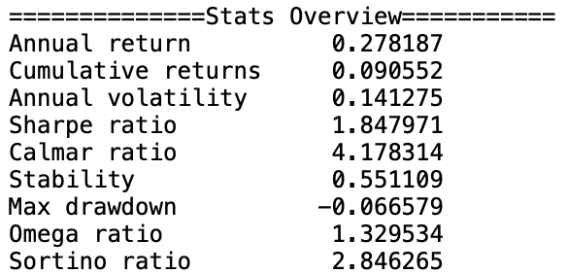
Backtesting Evaluation of trained models
account value
Classical Backtesting
Backtesting: trading on test data
Biases
Survivorship
Look ahead
Sample selection
Optimisation
…
Trading factors
Transaction costs
Slippage
Volume
Liquidity
Strategies
Trading
portfolio theory
buy & hold
Metrics
Annual/cumulative returns
Sharpe/calmar ratio
Alpha
Beta
…
Date
1101001
0001010
0110100
1011001

Slide 10
Backtesting Evaluation of trained models
Parameter optimisation
Normalized vs non-normalized
→ Better performance on normalized data
1101001
0001010
0110100
1011001

Slide 11
Backtesting Evaluation of trained models
Parameter optimisation
Low vs high transaction costs
→ Higher account value using low transaction costs
→But: very unstable performance
→Use of high transaction costs for future tests
1101001
0001010
0110100
1011001

Slide 12
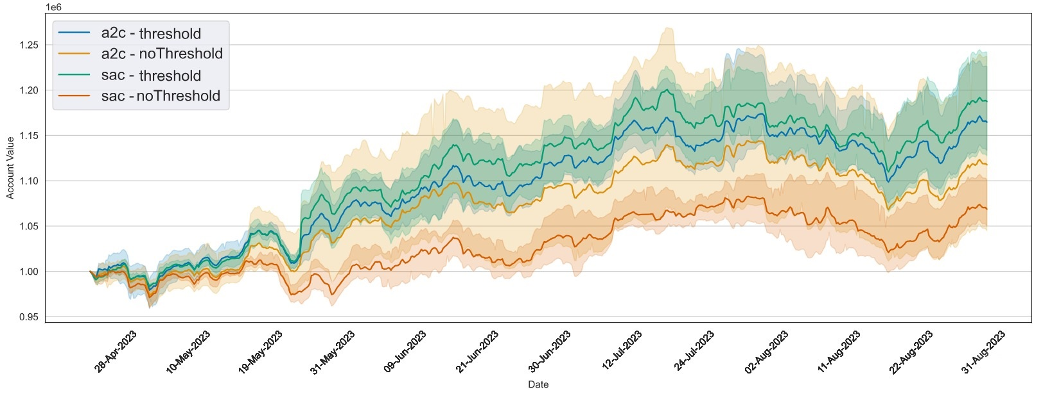
Backtesting Evaluation of trained models
Parameter optimisation
Threshold vs no Threshold
→higher account value and more stability using a threshold
1101001
0001010
0110100
1011001

Slide 13
Backtesting Evaluation of trained models
Parameter optimisation
Smoothed vs non-smoothed
→ Better performance on smoothed data
1101001
0001010
0110100
1011001

Slide 14
Backtesting Evaluation of trained models
Parameter optimisation
Sentiment vs no Sentiment for daily data
1101001
0001010
0110100
1011001

Slide 15
Backtesting Evaluation of trained models
Parameter optimisation
Sentiment vs no Sentiment for hourly data
1101001
0001010
0110100
1011001

Slide 16
Backtesting Evaluation of trained models
Parameter optimisation
Sentiment vs no Sentiment for daily data for SAC
1101001
0001010
0110100
1011001

Slide 17
Backtesting Evaluation of trained models
Parameter optimisation
Sentiment vs no Sentiment for hourly data for DDPG
1101001
0001010
0110100
1011001

Slide 18
Backtesting Evaluation of trained models
1101001
0001010
0110100
1011001

Slide 19
Backtesting Evaluation of trained models
1101001
0001010
0110100
1011001

Slide 20
Backtesting Evaluation of trained models
Hourly
Consistently better performance
Daily
Consistently worse performance
1101001
0001010
0110100
1011001

Slide 21
Backtesting Evaluation of trained models
Model choice
Compared to classic strategies
→ Better performance of RL agents
1101001
0001010
0110100
1011001

Slide 22
Backtesting Evaluation of trained models
Model choice
Best models
1101001
0001010
0110100
1011001

Slide 23
Sensitivity analysis Making RL explainable
Basic idea
Analyse gradient of each feature of the state
Features with a consistently large gradient are more important than those with smaller gradients
Intuition for plot interpretation: a heatmap
day/ hour
state feature
1101001
0001010
0110100
1011001

Slide 24
Sensitivity analysis Making RL explainable
Basic idea
Analyse gradient of each feature of the state
Features with a consistently large gradient are more important than those with smaller gradients
Intuition for plot interpretation: a heatmap
Which features are the most important?
day/ hour
state feature
1101001
0001010
0110100
1011001

Slide 25
Sensitivity analysis Making RL explainable
Basic idea
Analyse gradient of each feature of the state
Features with a consistently large gradient are more important than those with smaller gradients
Intuition for plot interpretation: a heatmap
Which features are the most important?
Which stocks are the most important?
day/ hour
state feature
1101001
0001010
0110100
1011001

Slide 26
Sensitivity analysis Making RL explainable
Basic idea
Analyse gradient of each feature of the state
Features with a consistently large gradient are more important than those with smaller gradients
Intuition for plot interpretation: a heatmap
Which features are the most important?
Which stocks are the most important?
Which days are the most influential?
day/ hour
state feature
1101001
0001010
0110100
1011001

Slide 27
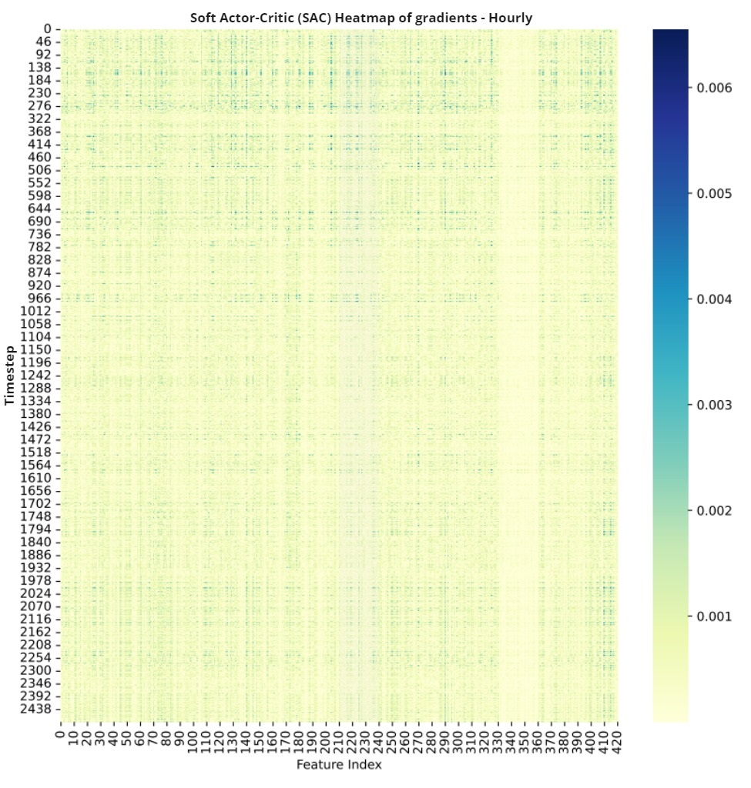
Sensitivity analysis Making RL explainable
Most important features: SAC hourly
One block (330-360) has clearly very low gradients compared to other values
Block of random values (ignored by agent)
Another block (210-240) has slightly higher gradients compared to other values
Corresponds to TI dx_30
1101001
0001010
0110100
1011001

Slide 28
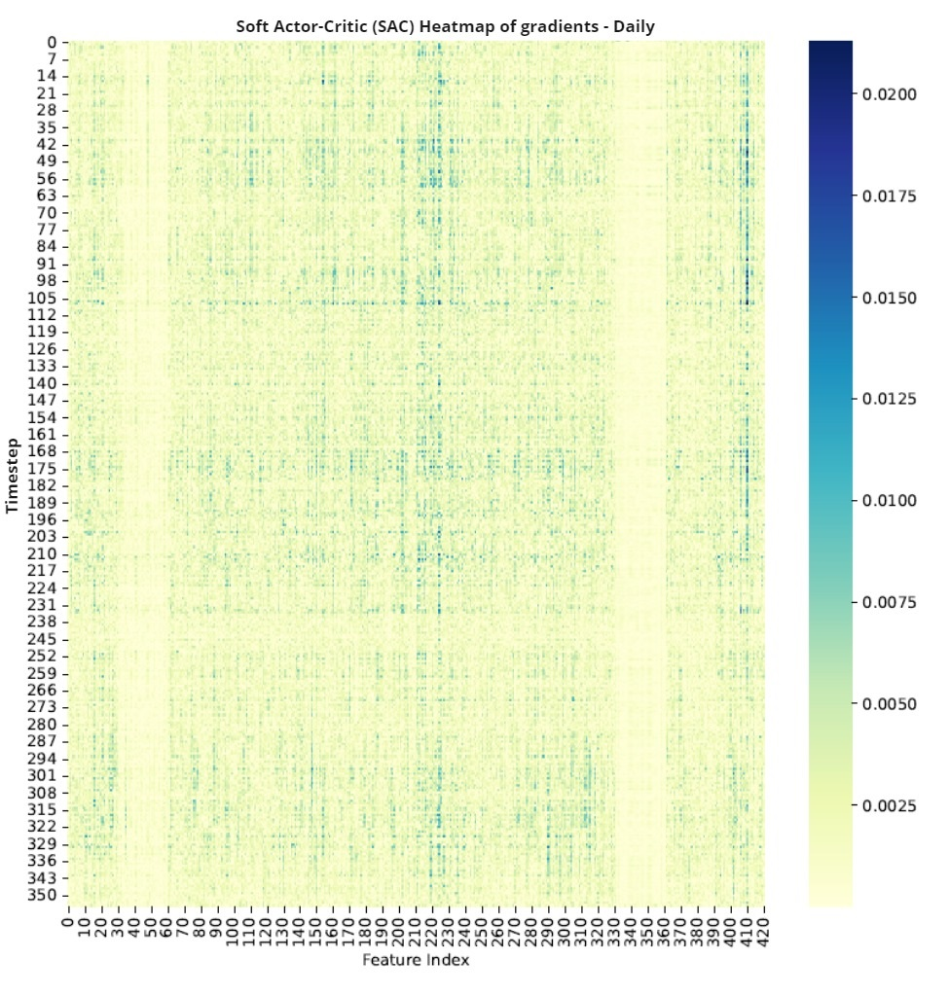
Sensitivity analysis Making RL explainable
Most important features: SAC daily
Block of random values (330-360) is still ignored by agent
Another block (30-60) has low gradients compared to other values
Block of number of shares (ignored by agent)
Still slightly higher gradients in block (210-240)
Corresponds TI dx_30
1101001
0001010
0110100
1011001

Slide 29
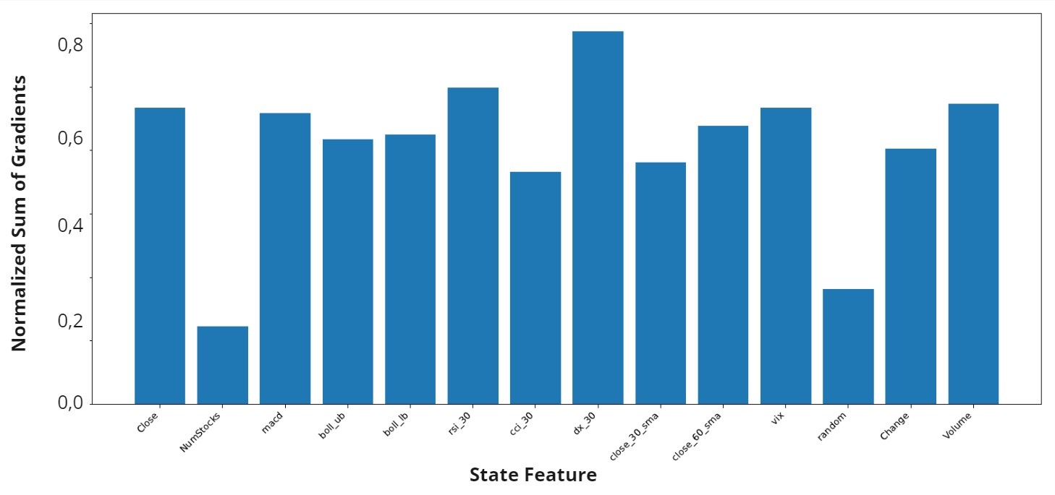
Sensitivity analysis Making RL explainable
Most important features: SAC daily
Ignored by the agent:
Number of shares
Block of random values
The most important TI:
DAX 30 index
Other TI have the same importance
1101001
0001010
0110100
1011001

Slide 30
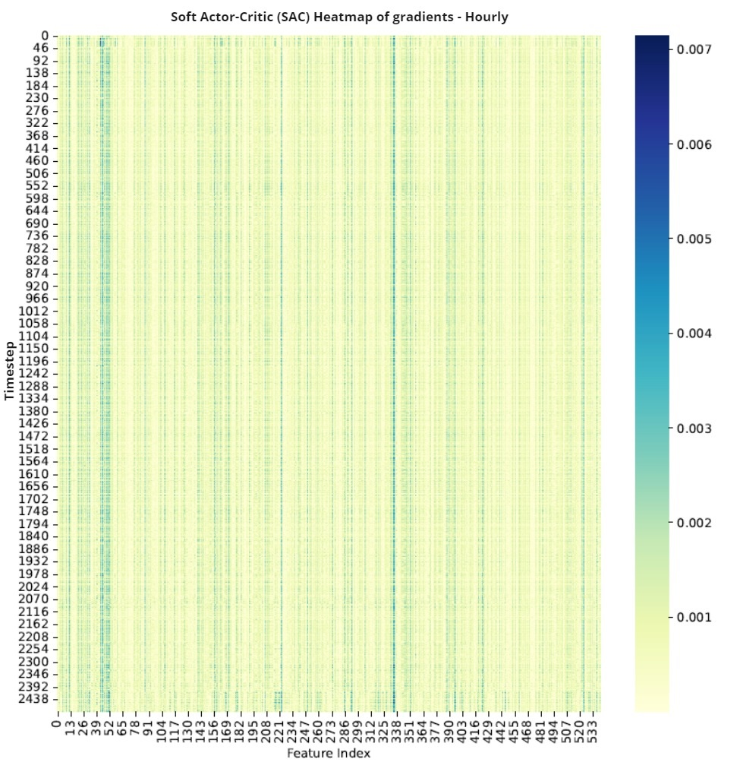
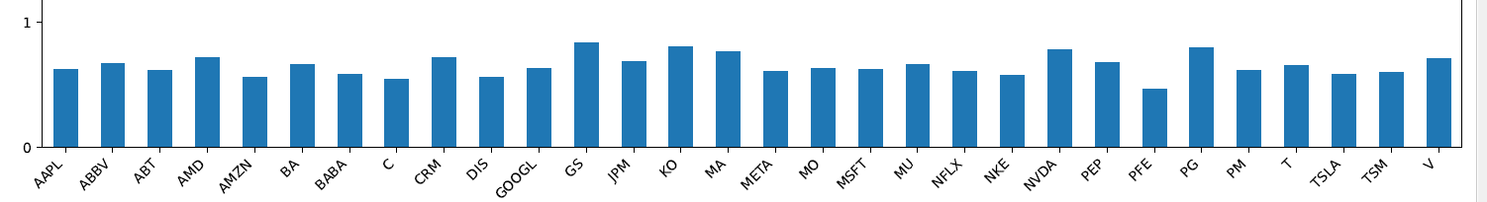
Sensitivity analysis Making RL explainable
Most important stocks: SAC hourly (with sentiment)
Clear vertical lines on a heatmap
Do they correspond to some specific stocks?
No, the sum of gradients for each stock appear to be uniformly distributed.
1101001
0001010
0110100
1011001

Slide 31
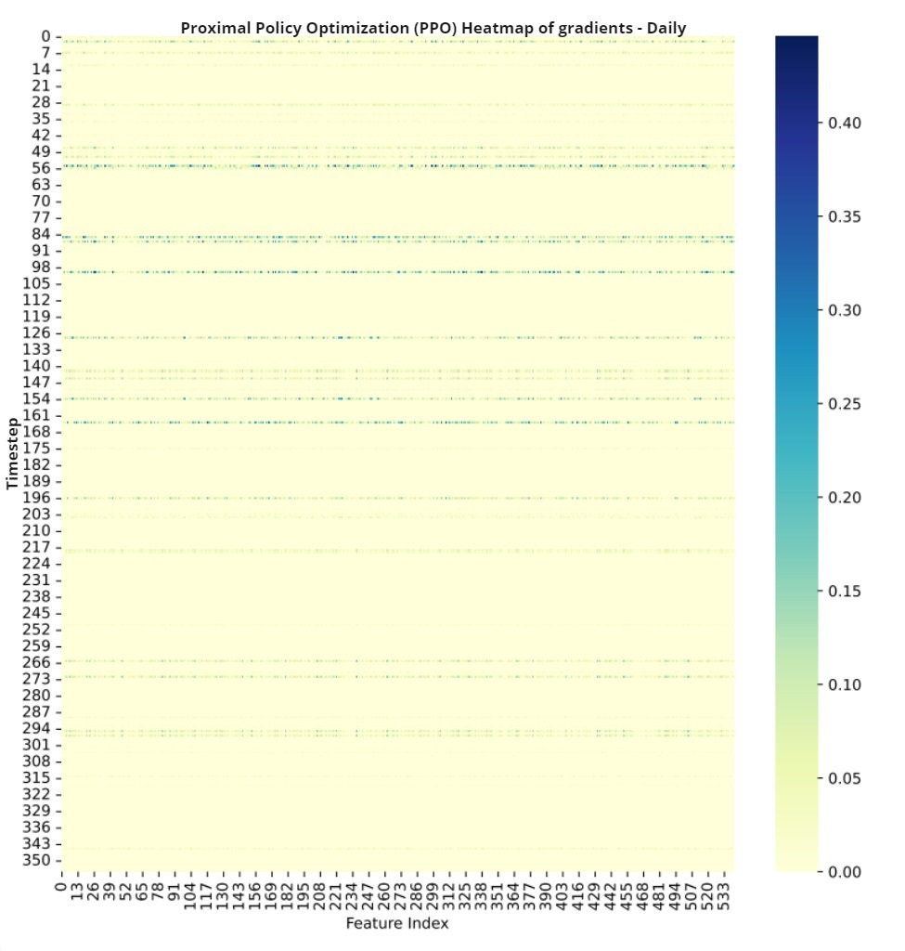
Sensitivity analysis Making RL explainable
PPO tends to find more important days
Clear horizontal lines on a heatmap, corresponding to more/less important days
Visualize gradient over time
1101001
0001010
0110100
1011001

Slide 32
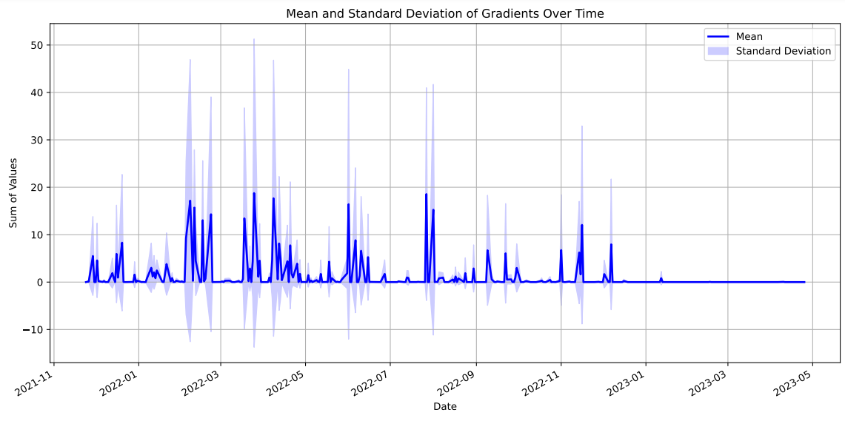
Sensitivity analysis Making RL explainable
PPO tends to find more important days
Clear horizontal lines on a heatmap, corresponding to more/less important days
Visualize gradient over time
High gradients starting from February 2022
Start of military conflict in the Ukraine, lead to increased market volatility
Small gradients from January 2023
1101001
0001010
0110100
1011001

Slide 33


Summary and Outlook Obstacles, dead ends and novel approaches
Obstacles
The sensitivity analysis could not exclude features
Could not re-train with new reduced data set
The hyperparameters could not be further improved
Overall low signal-to-noise ratio
Novel ideas
Replace sentiment data with fundamental/senate trading/weather/… other alternative data
Stronger focus on data and feature engineering: follow different approaches to produce stable signals from noisy data
→ Both approaches outside of actual reinforcement learning

Slide 34
Q
&
A

